Slide 1
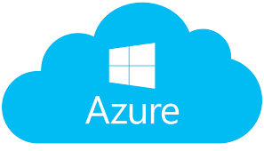
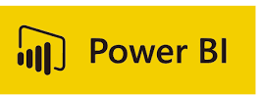
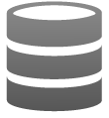

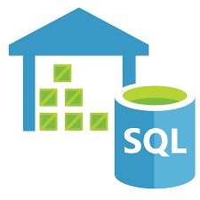
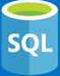










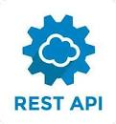
















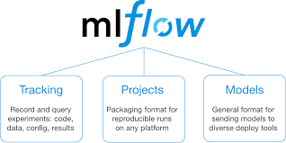







Azure Data Lake - Reference Architecture
Source layer
Aggregate layer
Analyze layer
Publish layer
Data Consumption
Source Layer
VPN
Data Access
Firewall
Curated Layer
Publish Layer
VPN
Azure Data Factory V2
Raw
Cleansed/
Enriched
AMI/CIS
ODBC/JDBC
Azure Databricks
Azure Databricks
PC
(VPN)
Azure SQL Data Warehouse & SQL DB
Azure Analysis Service
NMS
ADLS
Web Service
Files
ADLS
API
WMS
Event hub- Capture
Smart
Phone
Web Services
GIS
Express Route
Cosmos DB
Oracle Golden
Gate
Azure
DataBricks
Azure Functions
Azure API
APP
Downstream Data Systems
Semi-structured
Azure Event Hub
Un-structured
BizTalk
Azure Streaming Analytics
Insights/Models
Azure API
Management
Real Time Data
Azure API Management
& Logic APP
Azure ML
Databricks
ML Flow
Azure Cognitive Services
IOT
Audit balance and control
Batch
Authentication, Authorization, Accounting &
Data Protection
Secure Key Management
Orchestration
Monitoring and Administration
Azure DevOps
Near realtime
Azure Active Directory
Data Factory
Real-time
Key Vault
Azure Monitor

Slide 2
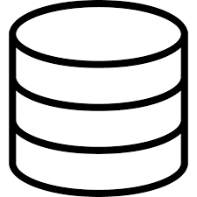


PoC Outage Analytics and Reporting Architecture
Source Layer
Data Ingestion
RAW
Data
Enrichment
Cleansed/Enriched
Layer
Data
Curation
Curated Layer
Analytics
Express Route
Reports,
Dashboards &
Visualization
AMI/CIS
Azure Data Factory
Raw Data
Azure Databricks
Azure Databricks
NMS
Batch
ADLS
Data Cleansing
Transaction Integration
Azure SQL Data Warehouse
Data Standardization
ADLS
Business Rules Processing
Data Quality checks
Data Aggregation
WMS
Azure Active Directory
Authentication, Authorization, Accounting &
Data Protection
Secure Key Management
Orchestration
Monitoring and Administration
Azure
DevOps
GIS
Azure Monitor
Data Factory

Slide 3




Proposed Architecture for Custom Filtering Solution
AMI Events (PONs, PRNs)*
Web service
Events
ITRON UIQ
Customer Event Filtering
Ping Validation
API APP
Web Service
Event Hub
Window Function
Option 1
Storage
Azure Streaming Analytics
Change Feed
Web Service
OMS
JMS
Option 2
Data Store
Notification
Blob
Cosmos DB
Azure Functions
BizTalk
Reference Data
File
Integration
CIS
Logic App
Azure SQL DB
Capture streaming event data from ITRON UIQ and store in Database for downstream applications/reporting systems
Event filtering
Expose data via APIs

